Slide 1
Archiving
Workflow
WMD
Data Capturing
www.wmd.de

Slide 2

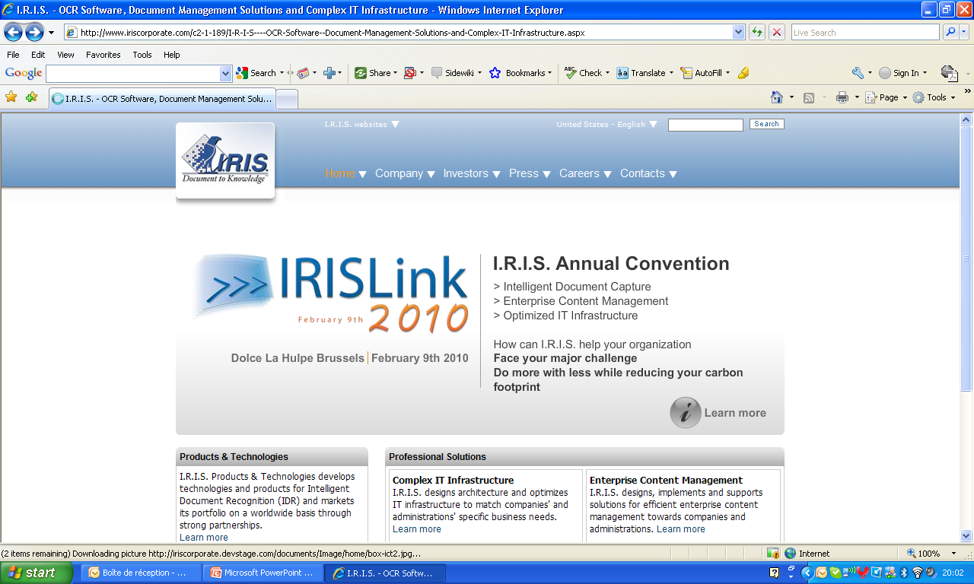
Enterprise Purchase to Pay Solution
WMD Benelux
Workflow Management & Document Consulting
Thursday, 04 February 2010

Slide 3
Agenda
WMD, The Company
Vinçotte Accounts Payable: Challenge & Results
WMD Enterprise Purchase to Pay Suite
Vinçotte Accounts Payable Solution
Vinçotte: value Add & Business Benefits
Vinçotte, The Implementation

Slide 4

Agenda
WMD, The Company
Vinçotte Accounts Payable: Challenge & Results
WMD Enterprise Purchase to Pay Suite
Vinçotte Accounts Payable Solution
Vinçotte: value Add & Business Benefits
Vinçotte, The Implementation

Slide 5

WMD, The Company
Enterprise “Purchase-To-Pay” Leadership
  Market-leading, comprehensive “Purchase-To-Pay” Suite for SAP
  Outstanding SAP Consulting Services
  Excellent P2P Business Process knowledge
Growth & profitability
  Fast growing (international) customer base & user community
  Rapid international expansion
  Profitable and cash flow positive

Slide 6
WMD, The Company
Over 650 customers worldwide
  Leading companies across all main verticals have chosen WMD’s innovative solutions
  High customer satisfaction (fast implementation, ease of use, great ROI)
Operations in Europe, Scandinavia, and Asia
  Headquartered in Germany (Ahrensburg) since 1994
  European operations, strategy & execution
  Partner driven strategy

Slide 7































A selection of Customers
Food & Drink Industry
Financial Services
Energy
Manufacturing

Slide 8






















A selection of Customers
Public
Retail
Industrial
Transport
Notes:
Eppendorf: biotechnology & life sciences
Vincotte: services (inspection, monitoring and certification)
Alzchem: Chemical industry
DLR: Deutsches Zentrum für Luft- und Raumfahrt in der Helmholtz-Gemeinschaft
HHLA: Hamburg Port & Logistics
CWS:

Slide 9


WMD & I.R.I.S. Partnership
WMD & I.R.I.S. Docutec = long-term, strategic partnership
Joint focus on Enterprise Purchase To Pay solutions for over a 16 years
Full & seamless integration between WMD & I.R.I.S. Docutec solutions
Over 100 joint customer implementations

Slide 10
Agenda
WMD, The Company
Vinçotte Accounts Payable: Challenge & Results
WMD Enterprise Purchase to Pay Suite
Vinçotte Accounts Payable Solution
Vinçotte: value Add & Business Benefits
Vinçotte, The Implementation

Slide 11
Company background
Belgian company, 14 subs. worldwide. 2,000 employees,
Provides over 130 specialised inspection, monitoring & certification services in the industrial sector
Business goals
Speed up AP process (only 15% of invoices with PO) to greatly improve audit compliance
Reduce (manual) costs of vendor invoice management
Increase efficiency & control of incoming invoice approval process
Notes:
FI/MM documents automatically generated (Invoice attribute OCR recognition. FI accounting lines generated by vendor templates or history).

Slide 12


Who has the invoice ? Is it lost?
Com-pliance?
Vendor
Relationship?
Accounting Manager
Challenges
Resolving errors & exceptions?
Faster
monthly closure?
SAP and non-SAP users?
Efficient access to invoices?
Efficient Reporting & Forecasting?
Minimize manual tasks?
Secure
Storage?

Slide 13
Results
30.000 invoices processed per year
Visibility on who blocks invoice, why, how long → audit compliance
Lower cost-per-invoice
Improved on-time payments
Improved ability to leverage cash discounts
Automated internal financial controls
AP clerks: far better understanding of SAP FI/MM design
Improved ratings by suppliers
Notes:
FI/MM documents automatically generated (Invoice attribute OCR recognition. FI accounting lines generated by vendor templates or history).

Slide 14
Agenda
WMD, The Company
Vinçotte Accounts Payable: Challenge & Results
WMD Enterprise Purchase to Pay Suite
Vinçotte Accounts Payable Solution
Vinçotte: value Add & Business Benefits
Vinçotte, The Implementation

Slide 15
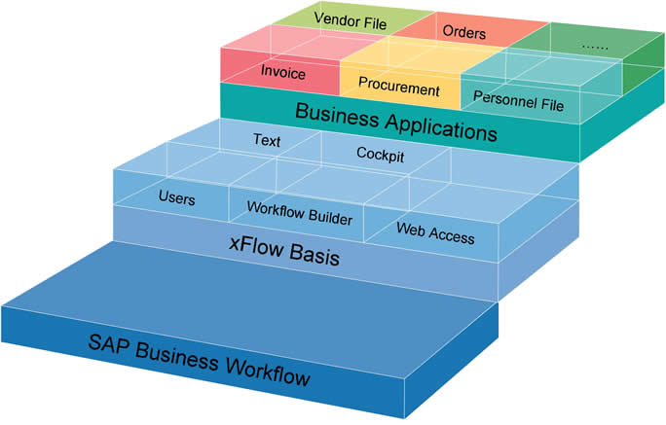
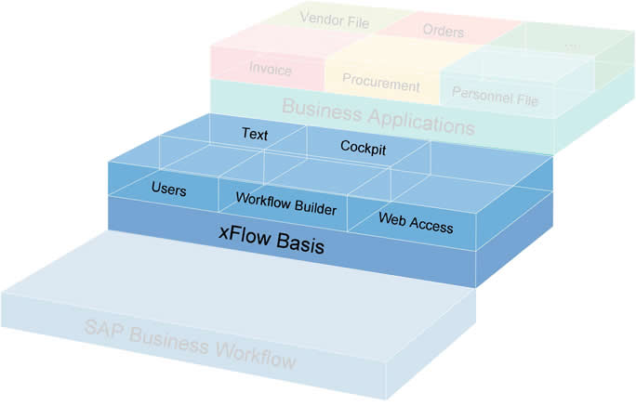
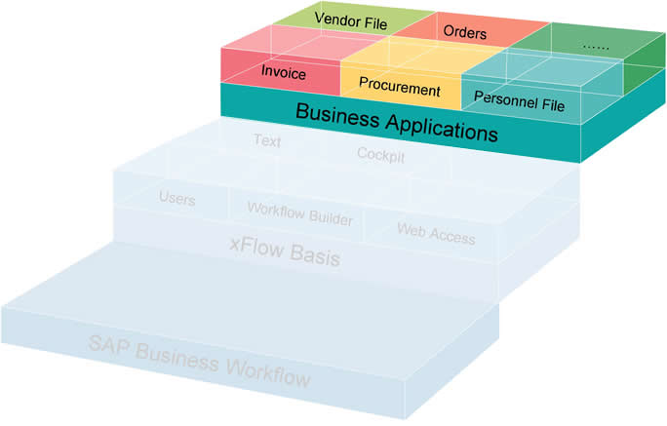
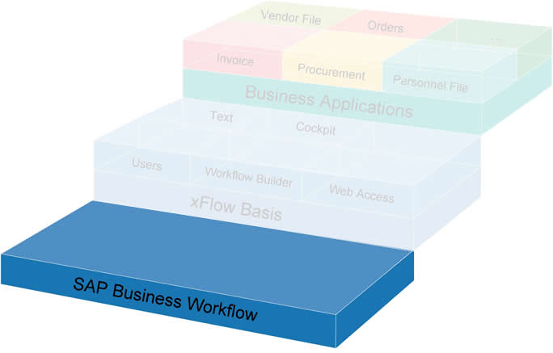
xFlow: a generic workflow solution
Generic SAP Workflow Solution, centralized administration
100% SAP integration
Out-of-the-box solution, fast implementation
No development, just configuration
Includes Non-SAP users
Over 200 Customers
“Business Applications” = specific business process solutions
Each Business App. can be analysed, searched or edited via SAP standard functionalities (“Business Workplace”, “Workflow Log”)
SAP Business Workflow is the foundation of xFlow®
SAP Business Workflow provides basic functionality (e.g. object types, methods, event control etc.)
xFlow® Basis provides core functionality for all Business Applications
Notes:
xFlow is totally integrated in SAP Business Workflow (also guarantees availability of various functions such as reports)
User management: role-based user and group administration (SAP, NON-SAP and LDAP users)
Text system (for translation of all xFlow elements into any desired language or company specific terminology)
Workflow Builder (graphical user interface to create Workflow diagrams/sequences)
Cockpit (for overview, administration, analysis of all xFlow® processes)
WEB (for utilising various xFlow® functions via the web / internet browser)

Slide 16



Procurement Solution for SAP
Vendor Invoice Processing Solution for SAP
Vendor File Solution for SAP
Enterprise Purchase to Pay
Solution for SAP

Slide 17






Slide 18
Agenda
WMD, The Company
Vinçotte Accounts Payable: Challenge & Results
WMD Enterprise Purchase to Pay Suite
Vinçotte Accounts Payable Solution
Vinçotte: value Add & Business Benefits
Vinçotte, The Implementation

Slide 19

Scanning
OCR – SAP Integration
SAP Vendor Invoice Process
SAP Archive
Enterprise Invoice to Pay
Solution for SAP

Slide 20
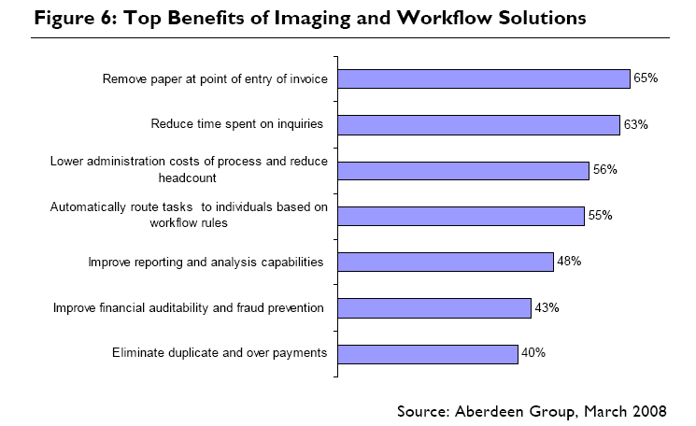
Benefits of automating the AP process: a known fact

Slide 21



WMD Enterprise Invoice-to-Pay Solution
Data Capture
OCR
SAP Data Transfer
SAP AP Process
SAP Archive
Content Server

Slide 22
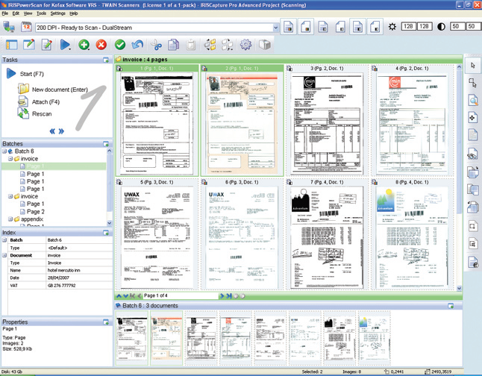
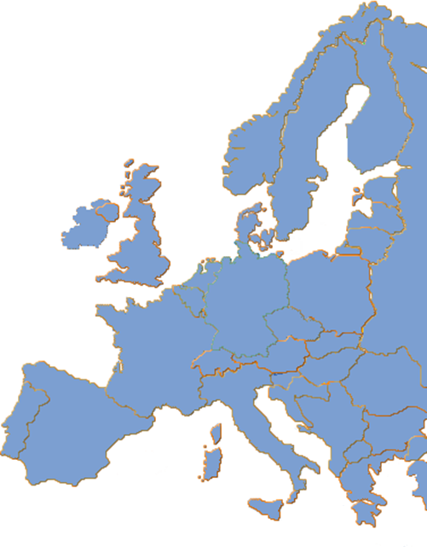

Distributed Scanning/Capturing
Central Administration
High Availability
Automated safe Image Transfer
Supports MFP‘s
WMD Experience from many international projects

Slide 23



Scanning
Data Capture
(OCR)
Business Process
Workflow
Transfer SAP
Archive
ArchiveLink
Interface
Invoice

Slide 24
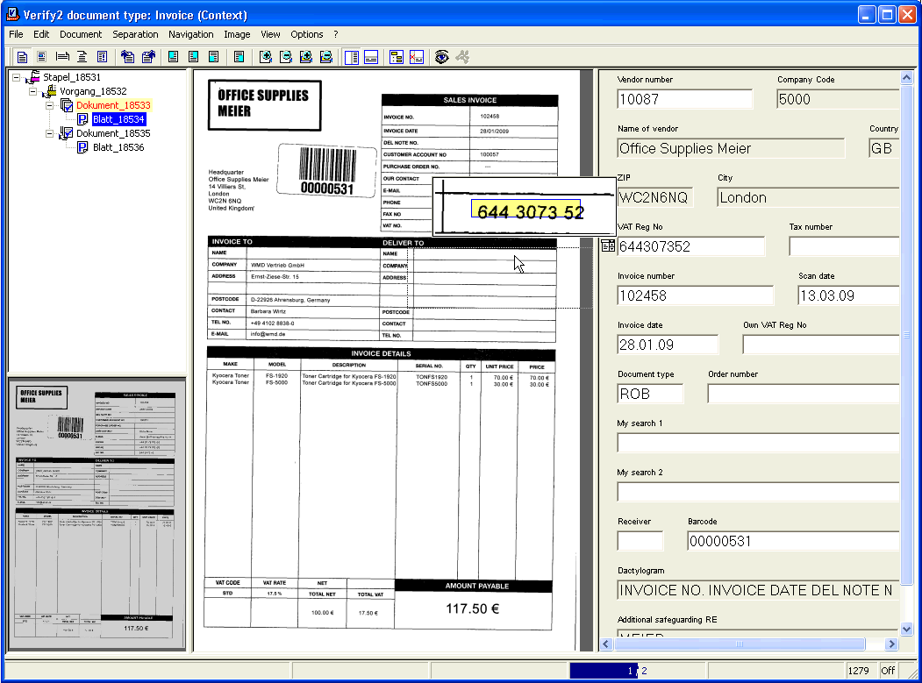
Docutec Xtract for Documents
One Product for all your documents
  Document independent
  140 languages supported
Scalable solution
  Expendable for further processes
Easy-to-use
  Intuitive interface
  No accounting knowledge required
WMD experience from more than 100 Docutec Xtract projects

Slide 25
Docutec Xtract for Documents
Free Form
  Capturing of information due to unique criterias in combination with provided rules
Template
  Pre-defined templates for optimized recognition of high-volume vendors
Training
  Combination of Free Form and Template approach. Training of information due to unique criterias for the optimized recognition in operative business

Slide 26
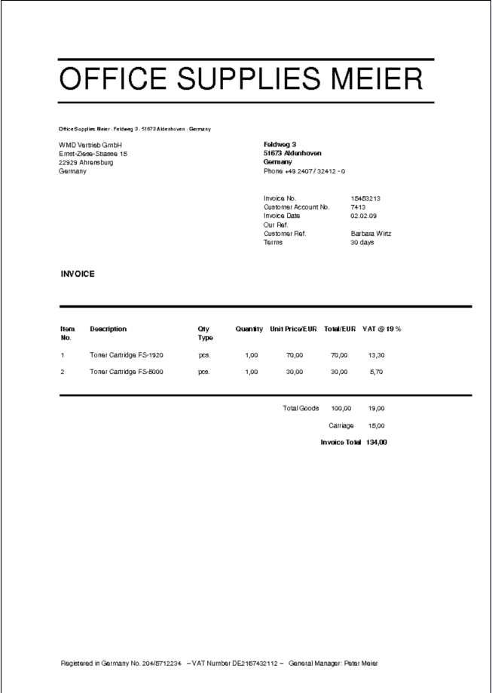
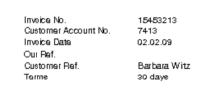
Docutec Xtract for Documents
Example
Invoice Date
  Found near the word „Invoice Date“
  Date which is not in future
  Earliest date on the invoice

Slide 27
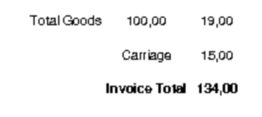
Docutec Xtract for Documents
Example
Invoice Date
  Found near the word „Invoice Date“
  Date which is not in future
  Earliest date on the invoice
Total Amount
  Sum of net amount + VAT = Total Amount
  If applicable + Carriage/Shipping etc.
  Highest amount on the invoice
+
+
✓

Slide 28
Scanning
Data Capture
(OCR)
Business Process
Workflow
Transfer SAP
Archive
ArchiveLink
Interface
Invoice

Slide 29




Images
Data Capture
Documents+ Index (XML)
Master Data
Interface
Archiving Dokuments + Index
Index + DocID (RFC)
Archive

Slide 30
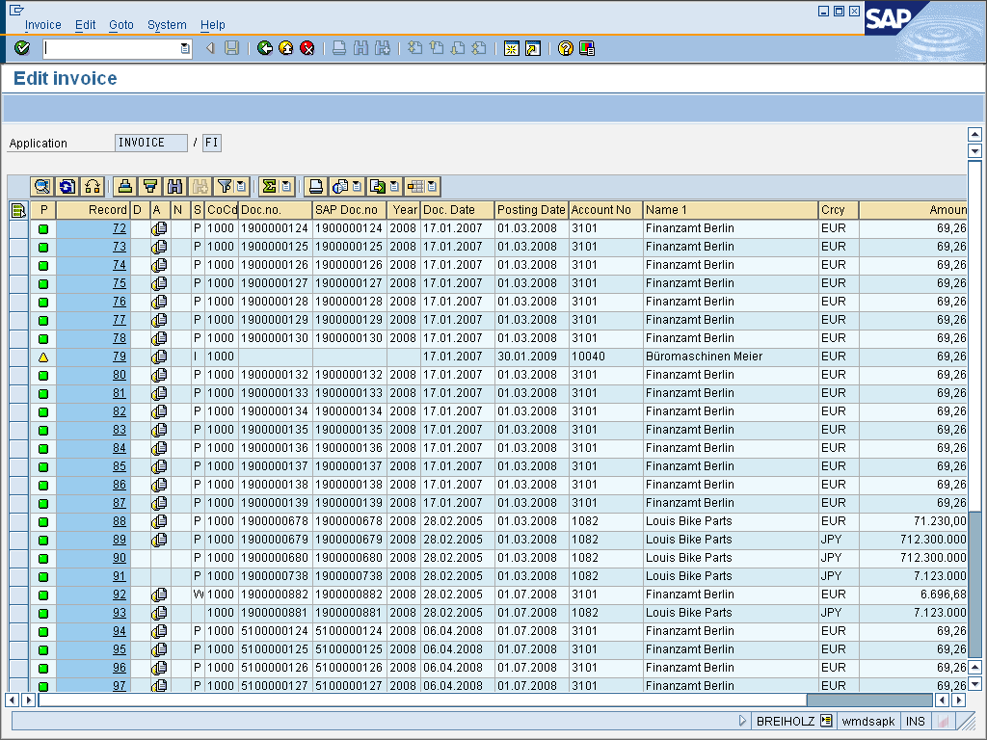
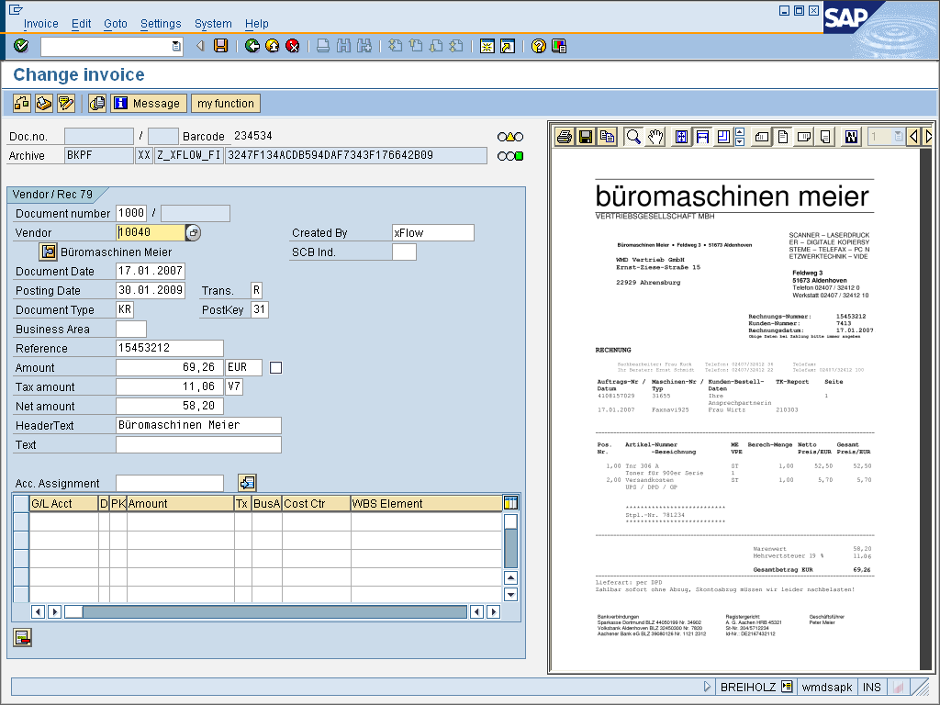
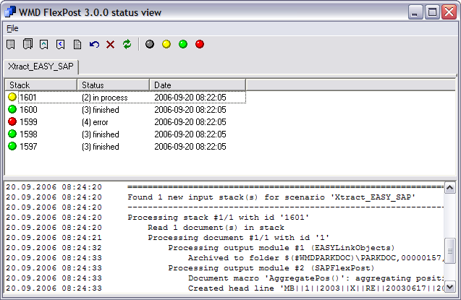
Complete SAP Integration
Status Monitoring:
Batched with xFlow Interface

Slide 31
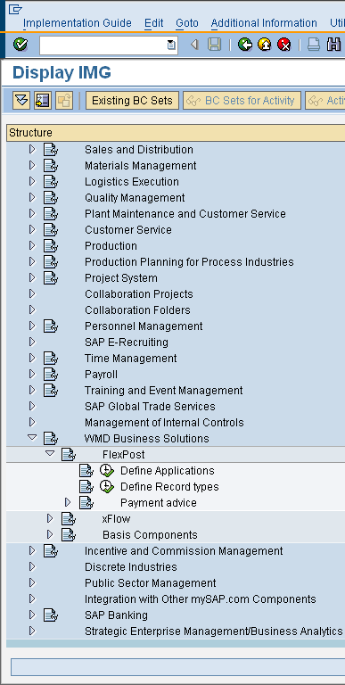
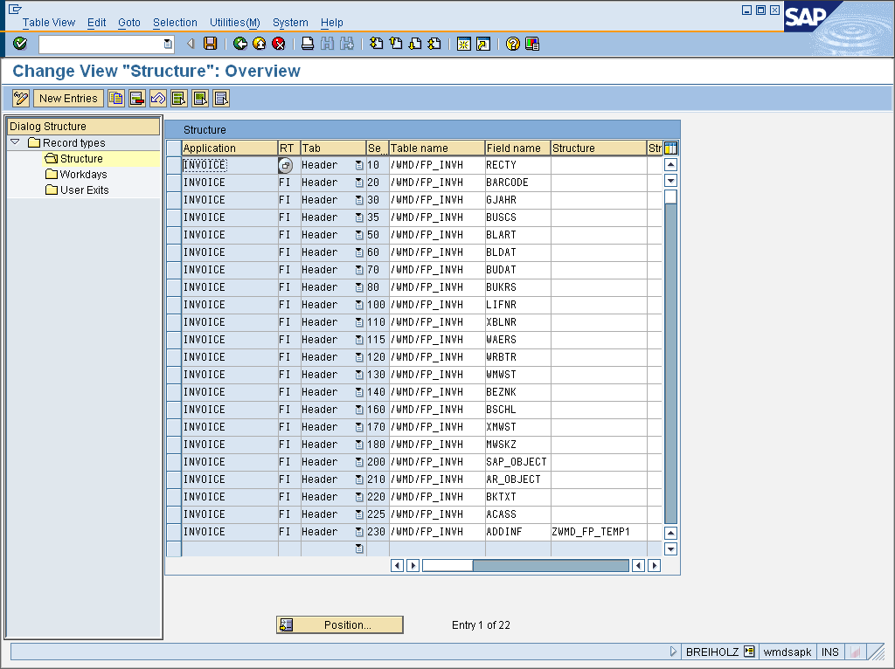
Centralized Customizing

Slide 32
Highlights
Validation Client in SAP
UserExits for Customer Development
Optional: In place or external Image Viewing
Solution Packages:
  Accounts Payable
  Intercompany
  Payment Advice
  Barcode (Late Archiving with Bar Code via ArchiveLink)
  SAP Records Management

Slide 33
Highlights
Automatic Account Assignment (any Items)
Support of all ArchiveLink-capable Archiving System
Optional Conversion of scanned Images
(into PDF or Multi-Tiff)
Direct API Support for EASY / SAPERION / Open Text
Centralized Monitoring

Slide 34
Scanning
Data Capture
(OCR)
Business Process
Workflow
Transfer SAP
Archive
ArchiveLink
Interface
Invoice

Slide 35

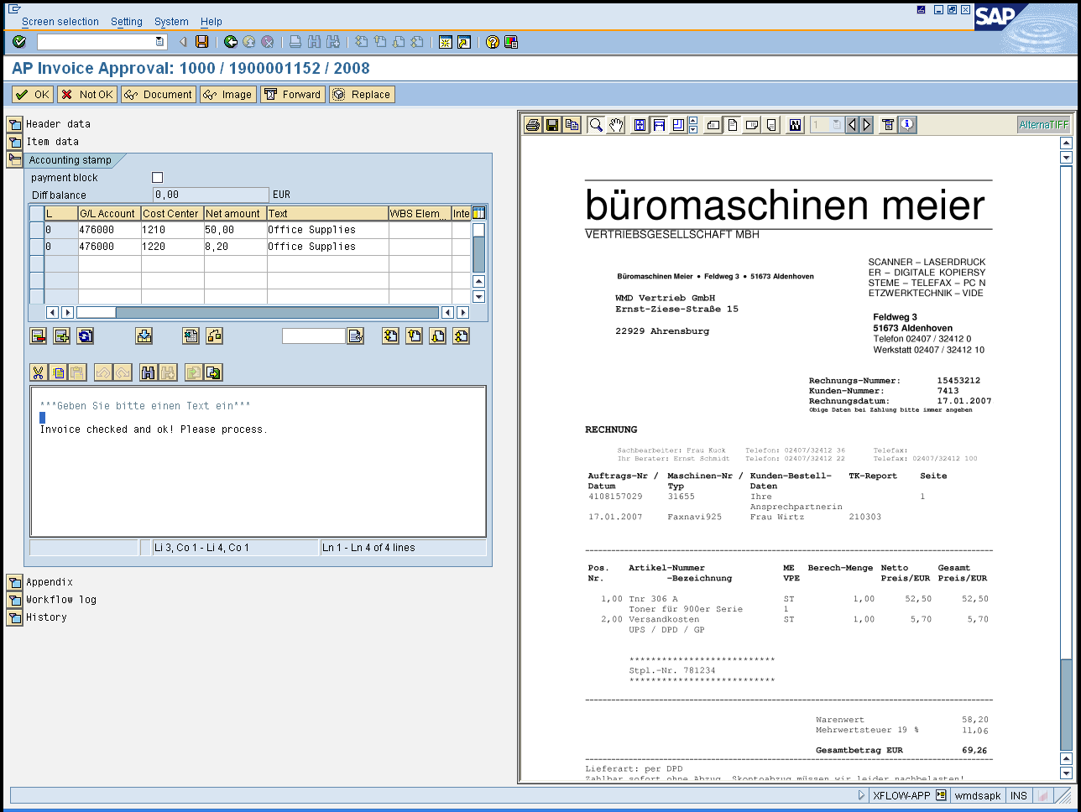
xFlow Accounting Stamp for SAP Users
Accounting Stamp
Invoice History
All data & images available
All inputs logged
Notes:
35

Slide 36
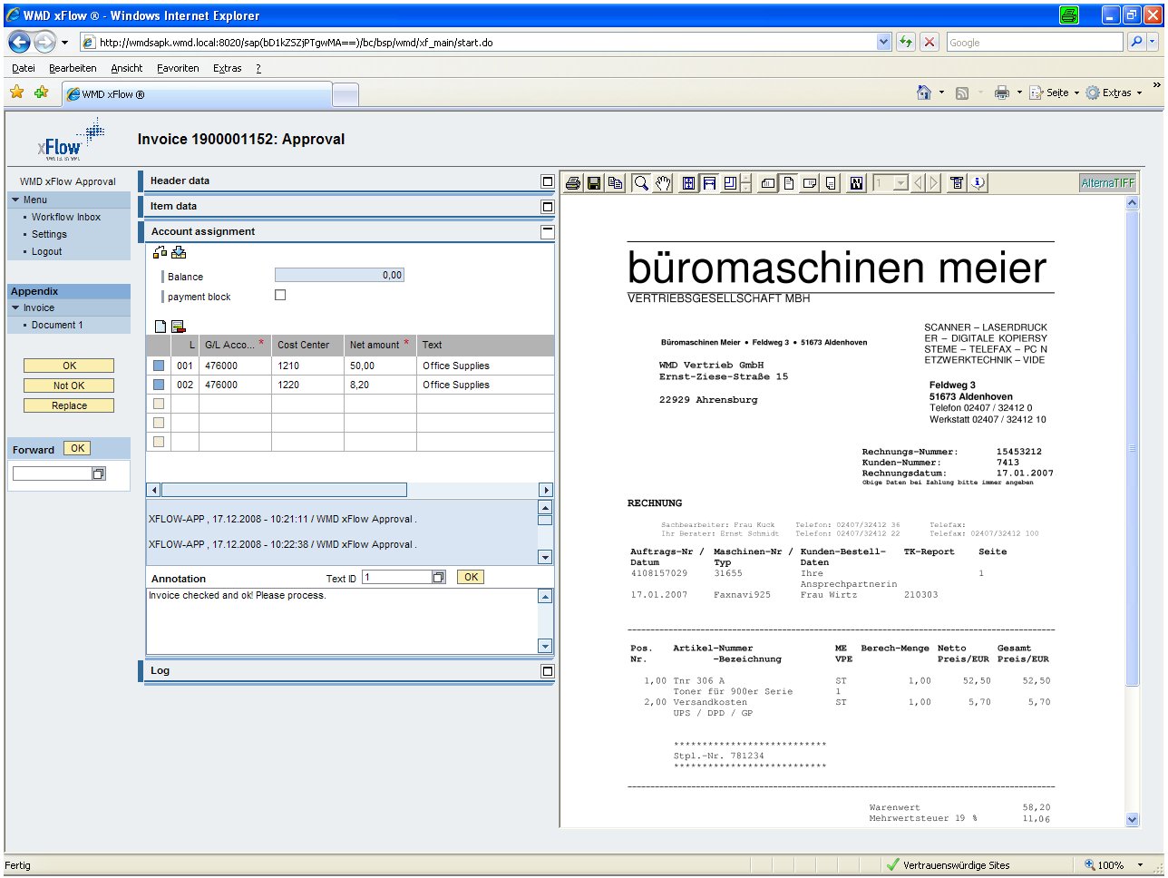
xFlow Accounting Stamp for Non-SAP Users
Easy to use interface for non-SAP users
Similar functionalities as for SAP users
Access from anywhere if needed
Notes:
36

Slide 37
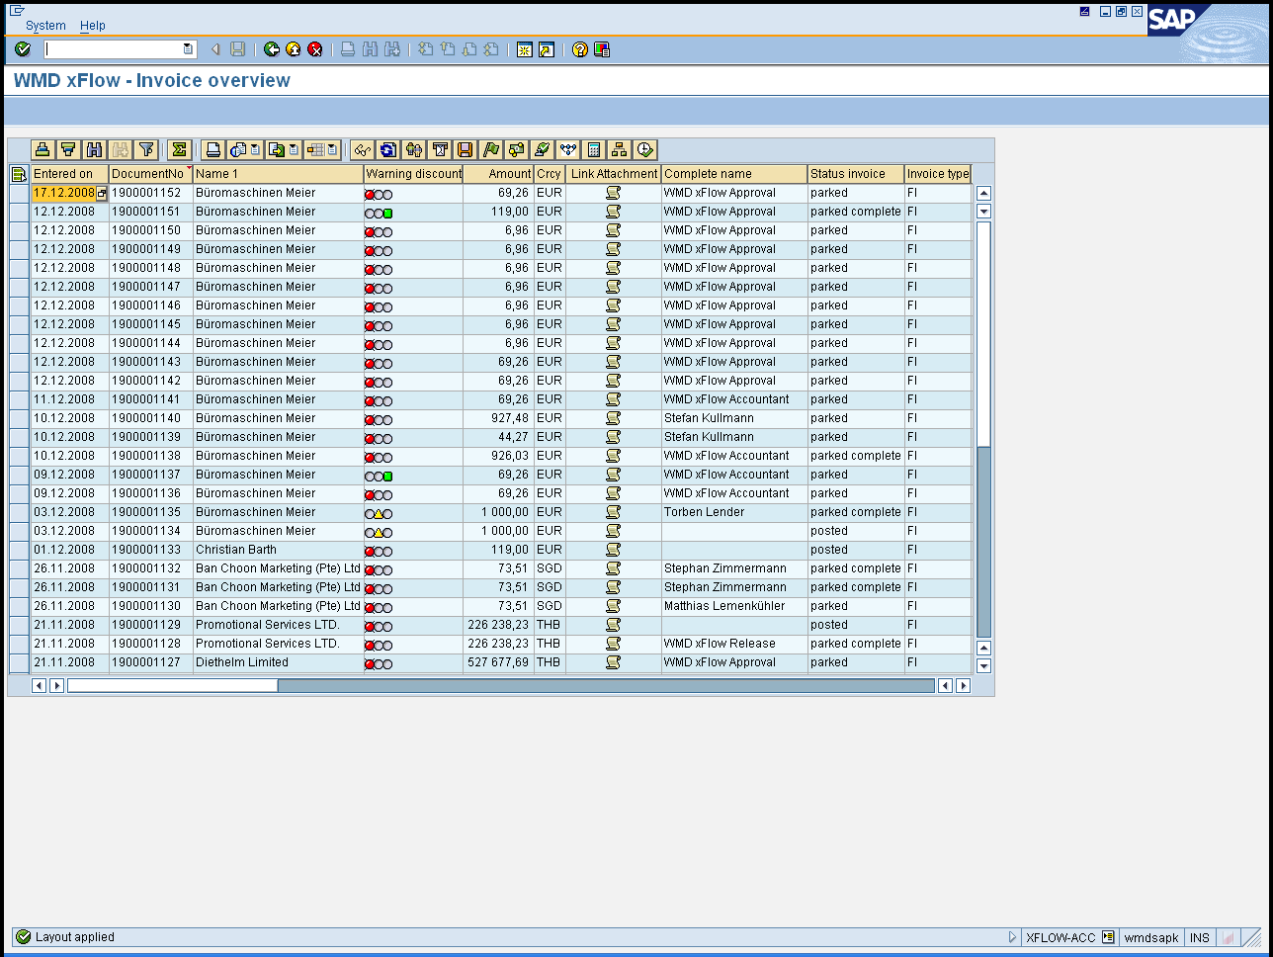
xFlow Invoice Overview
Overview of all invoices processes
Tracking functions
Direct access into SAP Document
Full transparency (who, where, how long etc.)

Slide 38
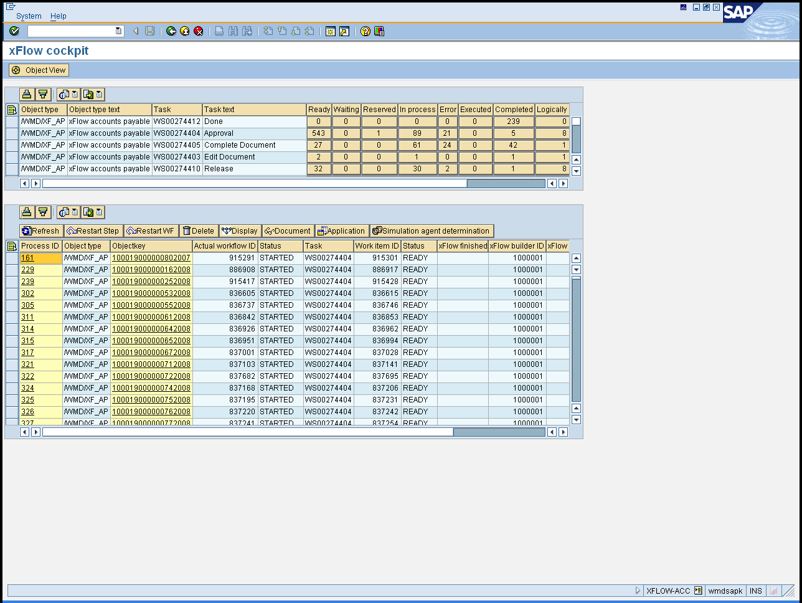
xFlow Cockpit
Overview of all xFlow processes
Administration
Logging
Direct access to
important transactions

Slide 39
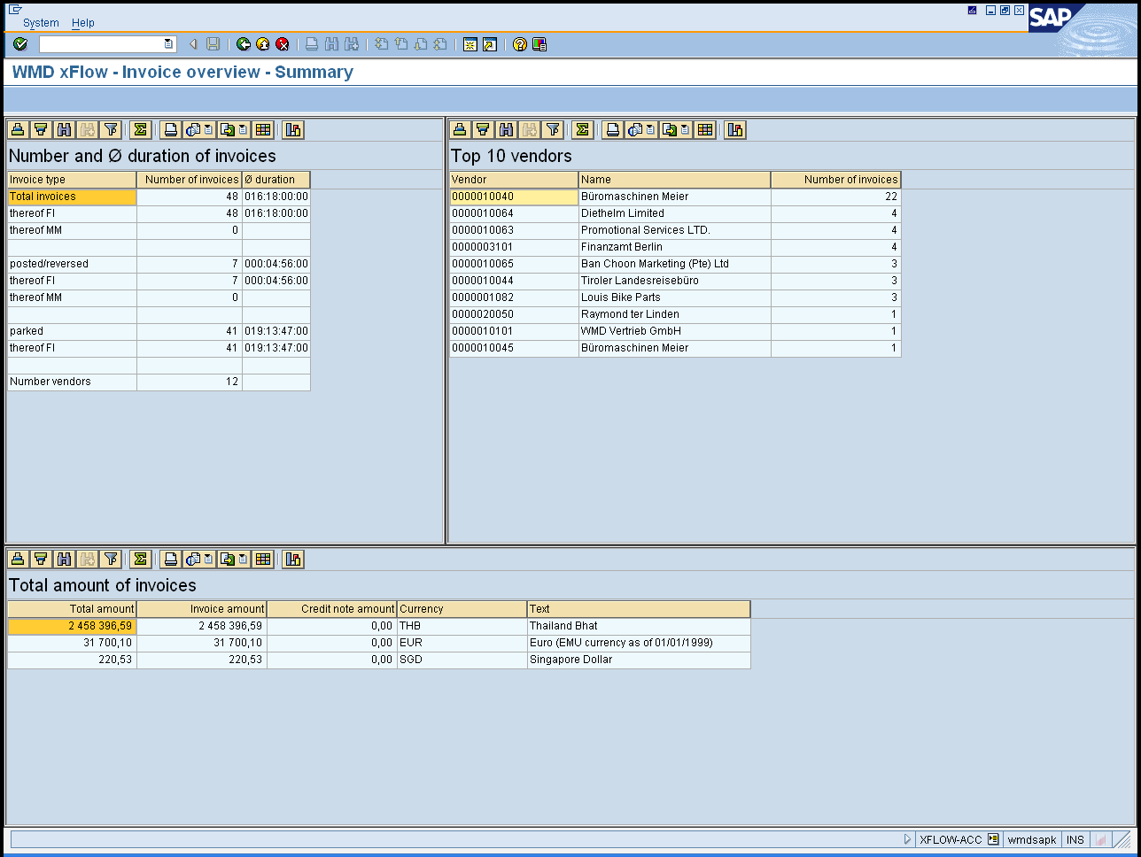
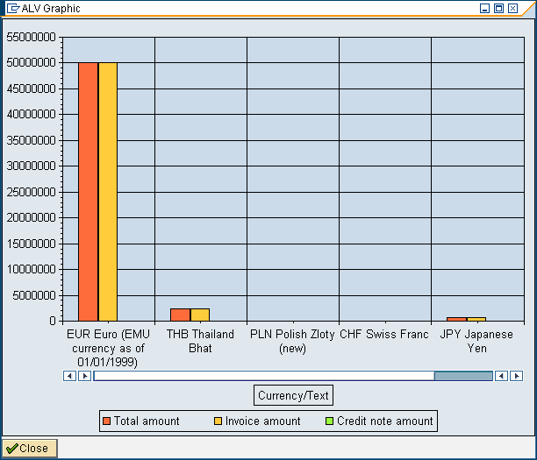
xFlow Management Summary
Management report on 10+ vendors
Overview of overall processing time
Numbers of total processed invoices
Notes:
39

Slide 40
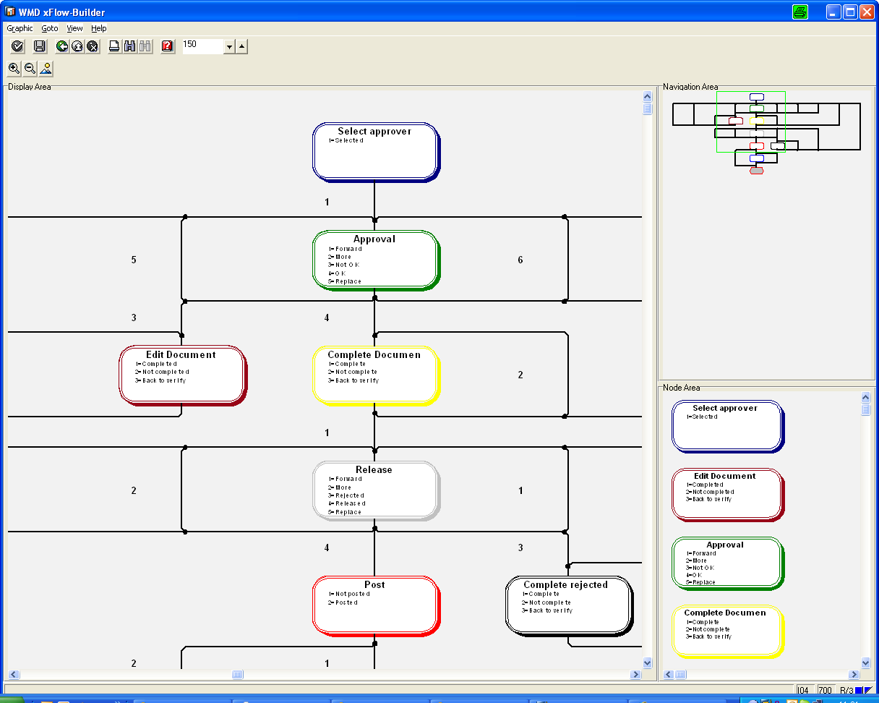
xFlow Workflow Builder
Easy to use interface to design or change workflows
Versioning of workflows
Flexibility & independent control on the workflow

Slide 41
Scanning
Data Capture
(OCR)
Business Process
Workflow
Transfer SAP
Archive
ArchiveLink
Interface
Invoice

Slide 42
Agenda
WMD, The Company
Vinçotte Accounts Payable: Challenge & Results
WMD Enterprise Purchase to Pay Suite
Vinçotte Accounts Payable Solution
Vinçotte: value Add & Business Benefits
Vinçotte, The Implementation

Slide 43





xFlow Suite Value Add
100% SAP Integrated, Intuitive to use
Out-of-the-box solution, fast implementation
Modular Enterprise Purchase-to-Pay Suite
Tested & tried solution: > 200 Customers

Slide 44



xFlow Suite Value Add
Web access for non-SAP users
Powerful tools: Invoice Overview, Cockpit...
Simple yet powerful customization: FI / MM skills only are needed

Slide 45






Business benefits
Eliminate manual labour, avoid paper copies
Reduce time spent on inquiries
Lower administration costs
Automate tasks thru workflow rules
Capture cash discounts, avoid late payments
Improve efficiency, reporting & audit-ability

Slide 46


Minimize Operating Costs
No document filing or loss
No document copying
Cost
Reduction
No document transporting
Optimize Cash Management
Capture all discounts
No late payment penalties
Improve Finance Productivity
Minimize manual labor costs through automation
Reduce cycle times (> 5 days)
Improve Service Levels & Visibility
Self-service for managers, employees, suppliers
Efficiency
Reduce process errors
Performance metrics & monitoring
Optimize Internal Controls
Automate segregation of duties
Audit trails & backup

Slide 47
Agenda
WMD, The Company
Vinçotte Accounts Payable: Challenge & Results
WMD Enterprise Purchase to Pay Suite
Vinçotte Accounts Payable Solution
Vinçotte: value Add & Business Benefits
Vinçotte, The Implementation

Slide 48

Implementing xFlow

Slide 49
Quick
analysis
Objective 1 : prepare initial prototype
Objective 2 : fixed cost proposal (if required)
Blueprint
Initial prototyping
Requirement analysis in deep
Prototyping
Solution customizing
Integration ( scanning – OCR – SAP – document storage )
Blueprint document ( solution description/project plan)
Testing
Go live
Prepar.
Userexit developments (if required)
Testing scenario preparation
Prototype fine tuning
Knowlegde transfer and documentation
Production system preparation
Go live

Slide 50
Hardware
Scanner
OCR
Software
Scanning application
OCR application
Services
SAP Web application server
SAP Content Server / Archive server
xFlow Interface
xFlow for invoices
Scanning / OCR
SAP-related services and
integration
Project management

Slide 51
Services
xFlow + Integration
Recommended effort : min. 40 days
Influencing factors:
* Special developments
* Environment complexity (involved parties, SAP constraints)
* Key-user involvement

Slide 52

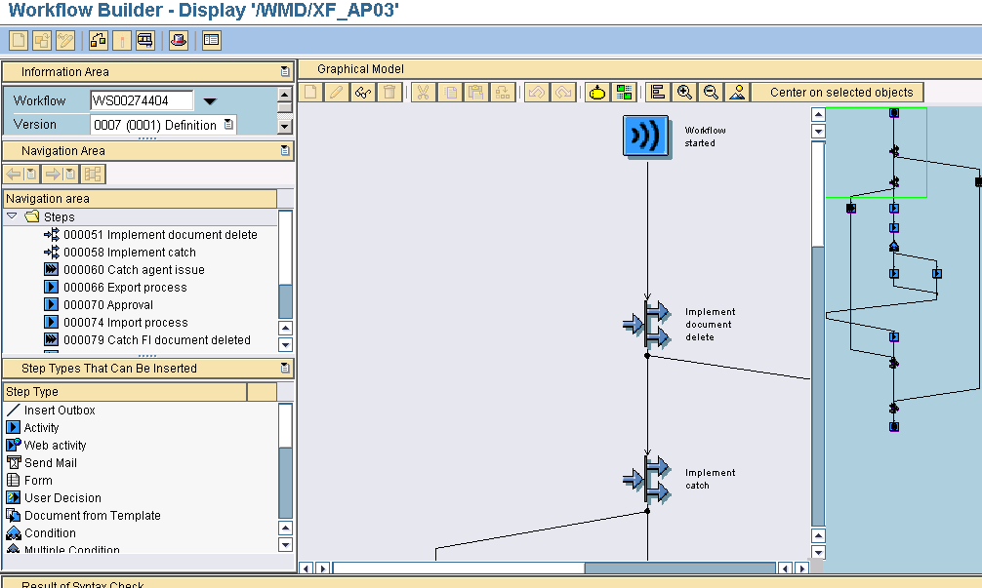
SAP Workflow skills & staff dependency
Long, expensive implementation
Not evolutive ( functionality, SAP upgrade ... )

Slide 53

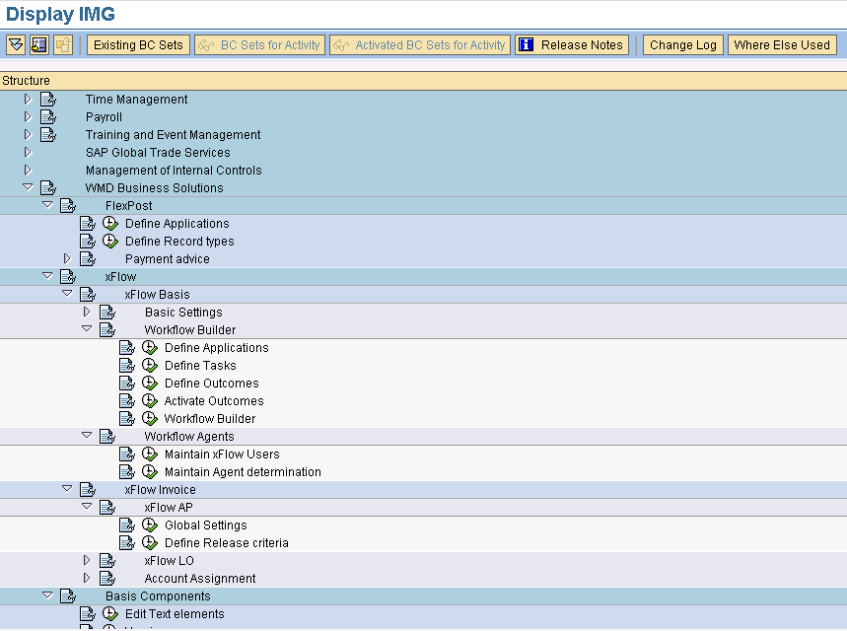
Reliance on SAP FI-MM skills only
SLA Support contract
Fast implementation
Evolutive (new functionality, SAP upgrade ...)

Slide 54

Thank you for your Attention!
WMD - Workflow Management & Document Consulting

